Slide 1

Simple neural networks

Slide 2
Neural Networks
Inspired by how our brains “work”
3 “waves”:
1960s: too simply, only ”linear”
1980s: breakthroughs: can do non-linear (xor), back-prop invented, but too slow, too little data, but a lot of fundamental research
2010s:
Much better hardware, GPUs (thank you gamers!) and other
Large labelled datasets
Some new ideas and algorithmic improvements

Slide 3
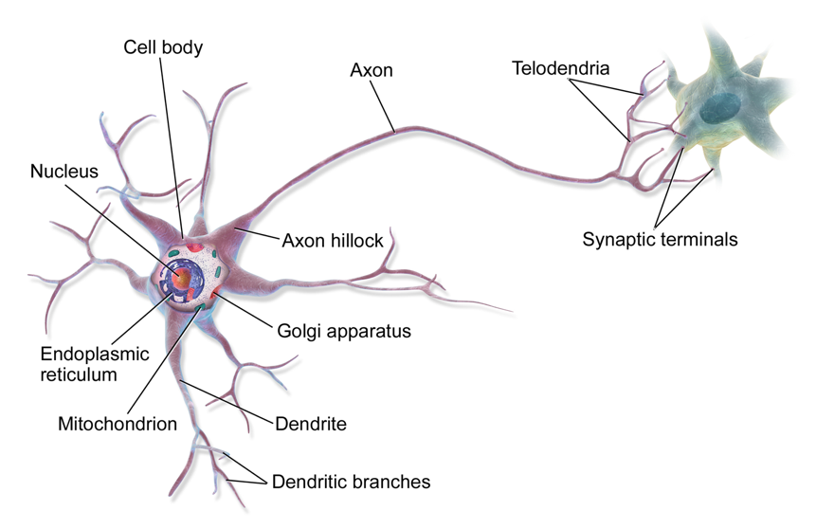
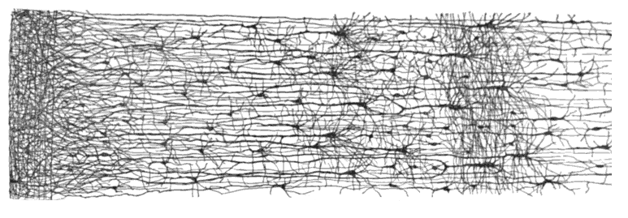
Biological neuron and networks
Send and integrate electrical signals, high latency
100 billion neurons in humans
The human brain in numbers: https://www.ncbi.nlm.nih.gov/pmc/articles/PMC2776484/

Slide 4
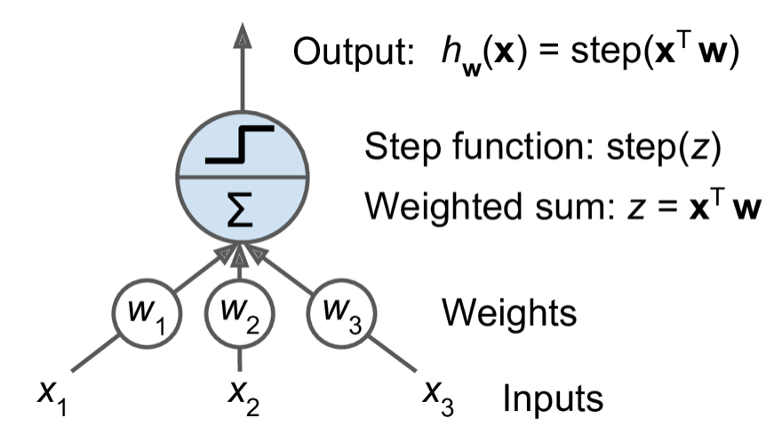
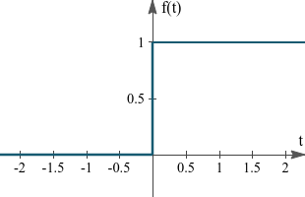
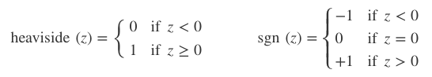
Perceptron
Threshold the weighted sum of the inputs:

Slide 5
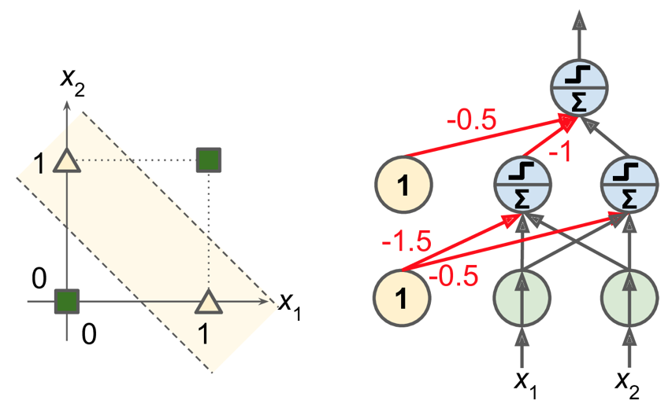
Xor?
Perceptron cannot learn Xor, but a multi-layer one can ☺

Slide 6
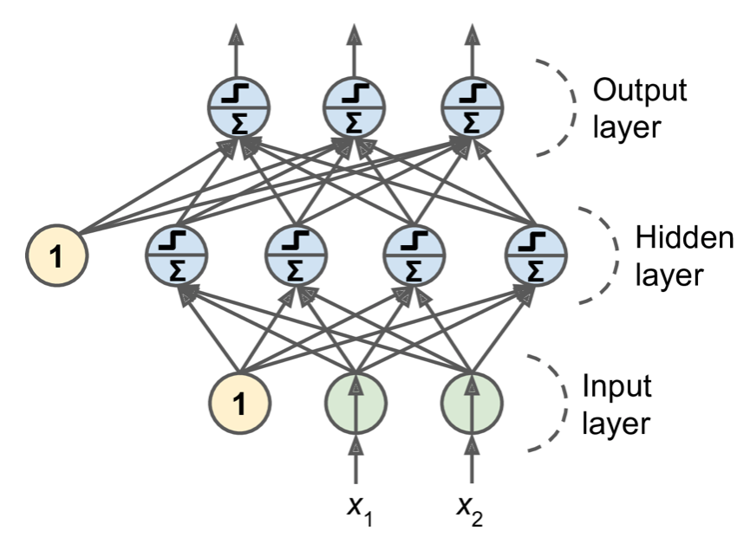
MLP, Feed forward network
Called Deep NN, if we stack many layers

Slide 7
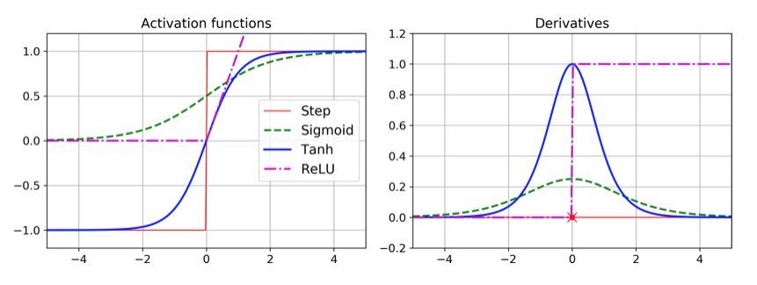
Activation functions
Standard ones: Sigmoid, Tanh, Relu

Slide 8
Using Keras
Keras is a high-level library for tensorflow, mxnet, (theano), pytorch
The book doesn’t use any library, but we recommend using Keras:
import keras
Installation is also quickly explained, but all we need is to enable GPU support in Colab (runtime->change runtime type -> T4 GPU)
Keras also supplies some benchmark datasets, but they often come in different shapes, e.g. images are 2-dim for grayscale or 3-dim for color. Cifar10 is 32x32x3: 32 by 32 pixels with 3 color channels for RGB, all values are from 0 up to including 255.

Slide 9
Using Keras
Neural network training: 3 step process
Define network
Compile network
Train network

Slide 10
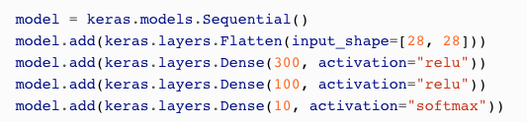
Using Keras
Defining the network (simple version):
Everything is a “layer”
Flatten: necessary because Dense expects 1-dim vectors, input_shape must be defined for the first layer
Dense: fully-connected, every unit connected to all inputs
Last layer has 10 units because we have 10 classes, uses ”softmax” to ensure all values are in 0.0-1.0, and sum to 1.0

Slide 11
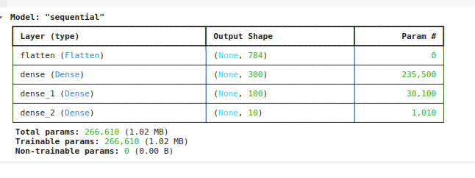
Using Keras
model.summary()

Slide 12
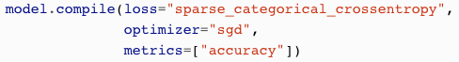
Using Keras
Compiling the model:
Class values in y_train are 0,..,9, we have 10 output units
“sparse_categorical_crossentropy” does the “right” thing
Can you keras.utils.to_categorical(y_train) to one-hot-encode target labels => use “categorical_crossentropy”
Binary prediction: use only 1 output with “sigmoid” activation and specify loss=”binary_crossentropy”
More about optimizers and metrics later

Slide 13
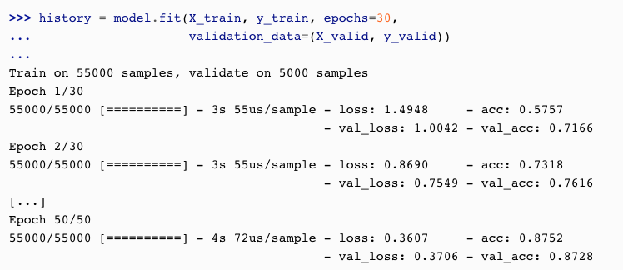
Using Keras
Training the model:

Slide 14
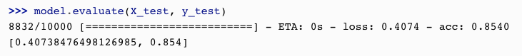
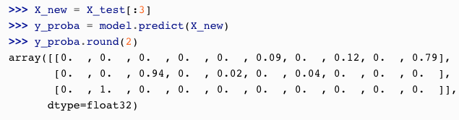
Using Keras
Using a trained model:

Slide 15
Training DNNs
No consensus on what is considered “deep”, but traditionally anything with more than 9 layers is “deep”
Is rather tricky, often seen as “black art”, rather than science
Issues include:
Difficulty training
Not enough (labelled) training data
Very slow training times
High risk of overfitting
But: there are solutions for all of these nowadays ☺

Slide 16
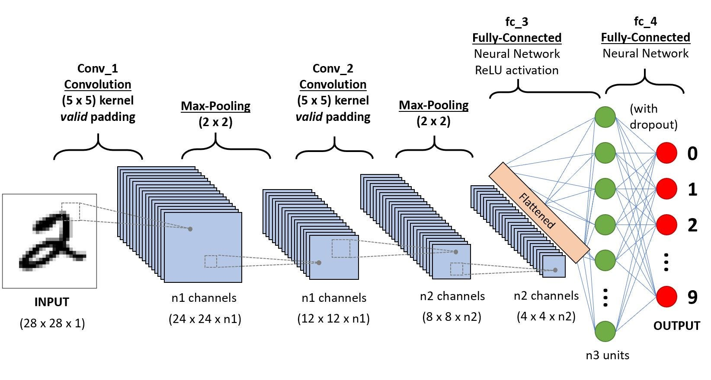

Neural networks for specialized applications
Convolutional neural networks for images (and other applications that has spatial relationships)
Recurrent neural networks for sequences (and other applications with temporal relationships)

Slide 17
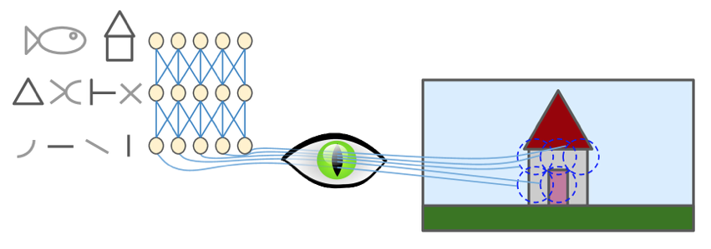
Biological inspiration (again)
100x100 image, 1000 units, 3 color channels: 30 millions weights
Humans have evolved specialised ‘hardware’ for vision:
CNN: 2 new types of layers: convolutions and max-pooling

Slide 18

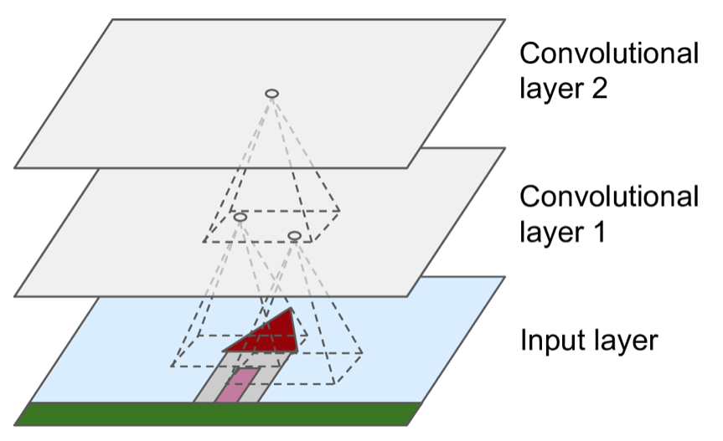
Convolutions
Compute weighted sums for each pixel’s small neighbourhood,
https://www.analyticsvidhya.com/blog/2021/05/convolutional-neural-networks-cnn/ and https://towardsdatascience.com/convolutional-neural-networks-explained-9cc5188c4939

Slide 19
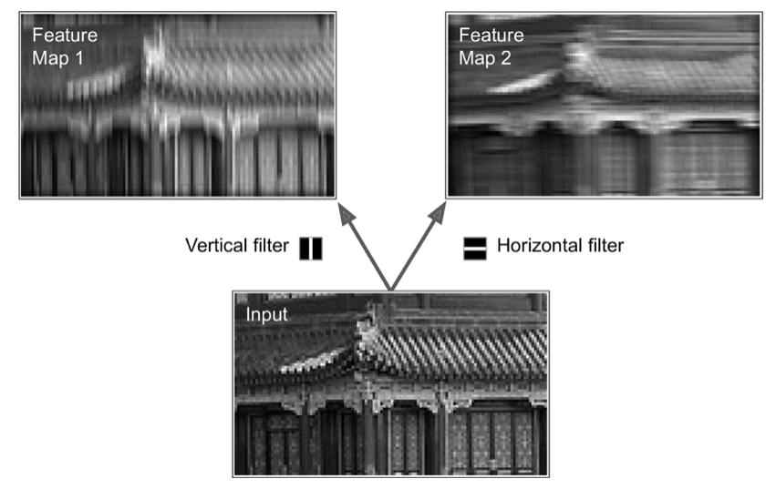
Convolution as filters
Convolutions act as filters, extract low-level features

Slide 20
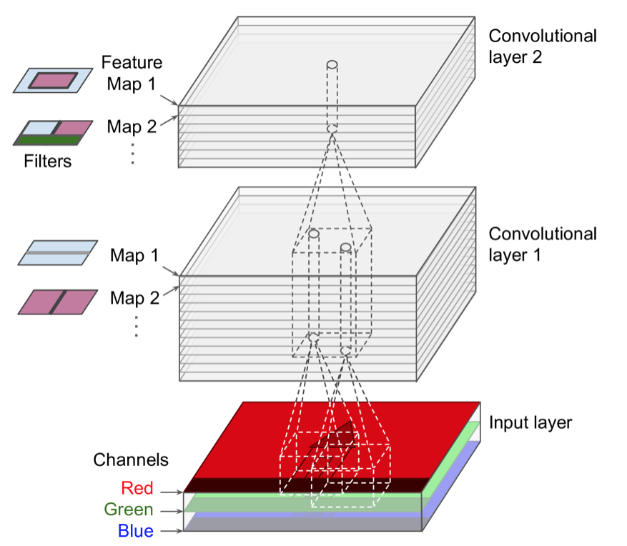
Many convs per layer
Often use many convolutions per layer, and many layers

Slide 21
Convs in layers?
Convolutions are a linear operation: weighted sum
Usually go across all color channels / feature maps
Early layers: low-level features
Later layers: combinations of low-level features => high-level features
Promise of DNN: features are learned automatically, no feature engineering needed ☺

Slide 22
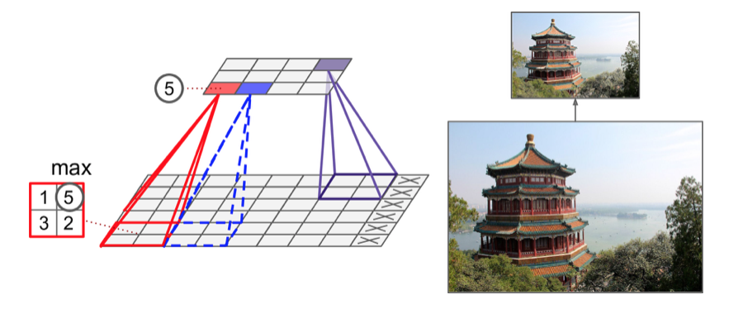
Max pooling
Non-linear operation, usually used for shrinking

Slide 23
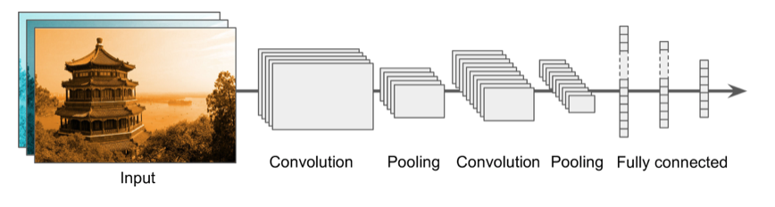
CNN architectures
Convs+poolings first, then Dense layers
Convs default: 3x3, except for first layer, which might larger ones, and also might use stride>1 values

Slide 24
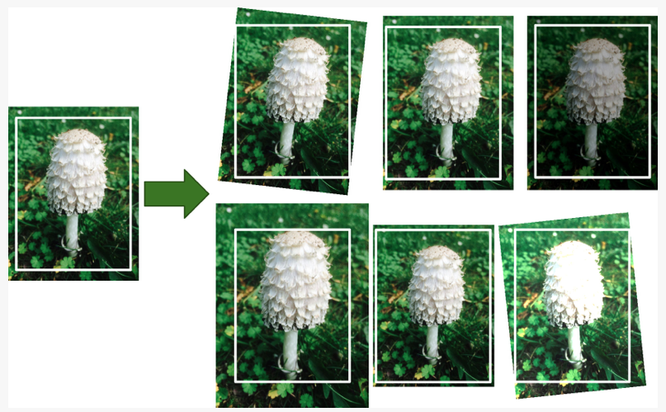
Data Augmentation
Generate more data by slightly corrupting examples

Slide 25
Transfer learning
https://www.tensorflow.org/api_docs/python/tf/keras/applications
base_model = keras.applications.resnet18(include_top=False,weights='imagenet',pooling='avg') pretrained_model = keras.models.clone_model(base_model) pretrained_model.set_weights(base_model.get_weights()) for layers in pretrained_model.layers: layers.trainable=False predictor_head=keras.layers.Dense(no_classes,activation='softmax')(pretrained_model.output) model=tf.keras.Model(inputs=pretrained_model.input, outputs=predictor_head)

Slide 26
Fine tuning best practices
Step 1) train the model with the inner layers frozen at a larger learning rate (i/e ADAM with learning rate 1e-4) for small number of epochs
model.compile(optimizer=keras.optimizers.Adam(learning_rate=1e-4), … ) model.fit(....)

Slide 27
Fine tuning continued
Step 2) Unfreeze the layers (except for the batch normalization layers)
for layer in model.layers:
if not isinstance(layer,keras.layers.BatchNormalization):
layer.trainable = True
Step 3) train the model at a smaller learning rate (typically 1/10th of the learning rate set in step 1) for large number of epochs
model.compile(optimizer=keras.optimizers.Adam(learning_rate=1e-5), … ) model.fit(....)

Slide 28
Regression Example

Slide 29
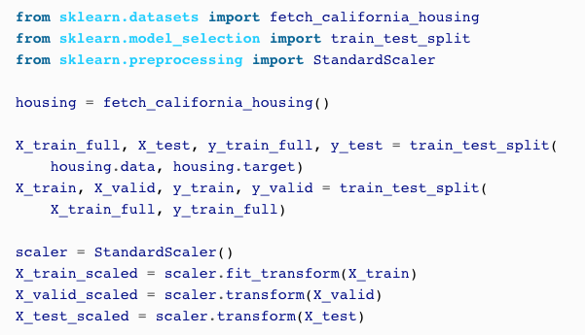
Using Keras
A simple regression net for california_housing:

Slide 30
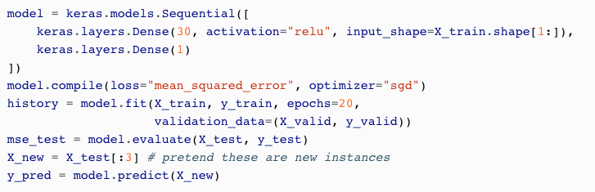
Using Keras
Define model, compile, train, and use:

Slide 31
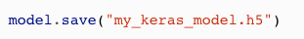
Using Keras
Saving and loading models:

Slide 32
How many layers?
Start with 1 or 2, and increase if necessary
Deep NNs for image classification can have 100s of layers
In theory, 1 (wide-enough) hidden layer can represent any smooth function, but
Might need millions of units
Might be very hard and slow to train
Often many smaller layers work better that one very wide one

Slide 33
Forecasting/predicting sequences

Slide 34
Sequences
Many interesting predictions problems are sequences, aka time series
Prices: stocks, commodities, …
Weather: temperature, rainfall, wind speed and direction
Trajectories: cars, balls, missiles
Language: spoken + written
Univariate time series: one value at a time
Multivariate time series: many values at each time point

Slide 35
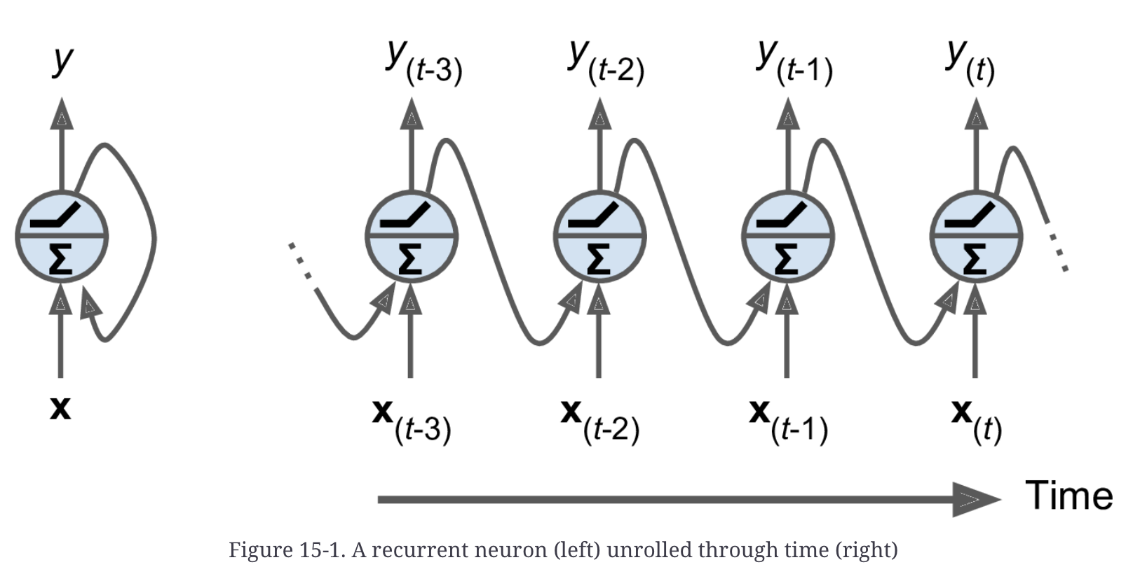
Recurrent neurons
Have ”memory”: additional input + output
”Unrolling”: visualizing the processing over time

Slide 36
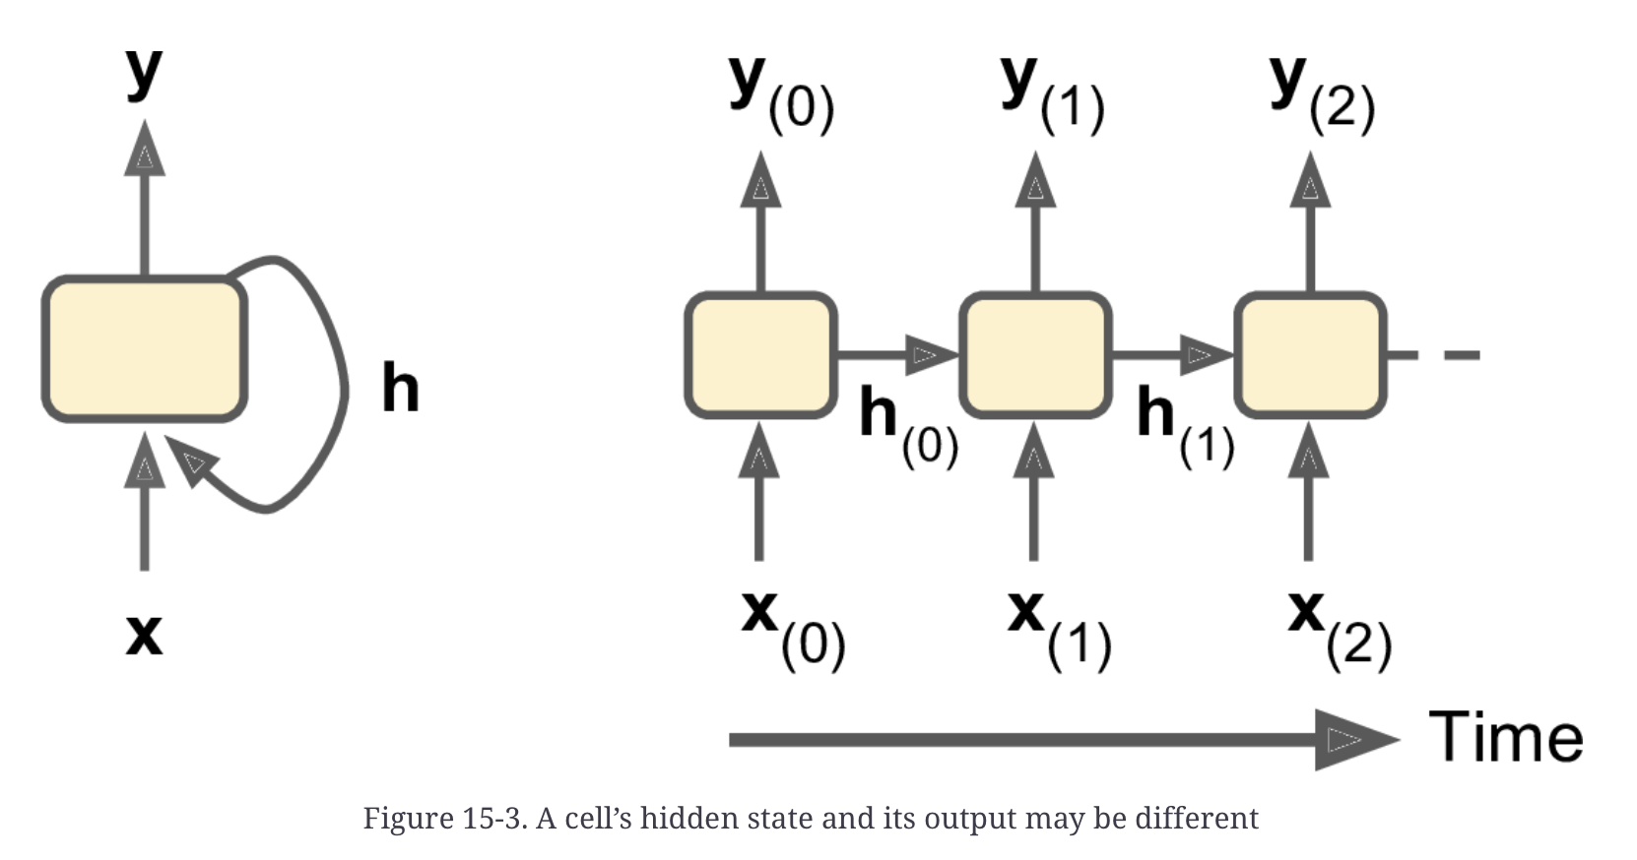
Output vs. Hidden
Output can be different from “hidden”, the “memory” being passed on:

Slide 37
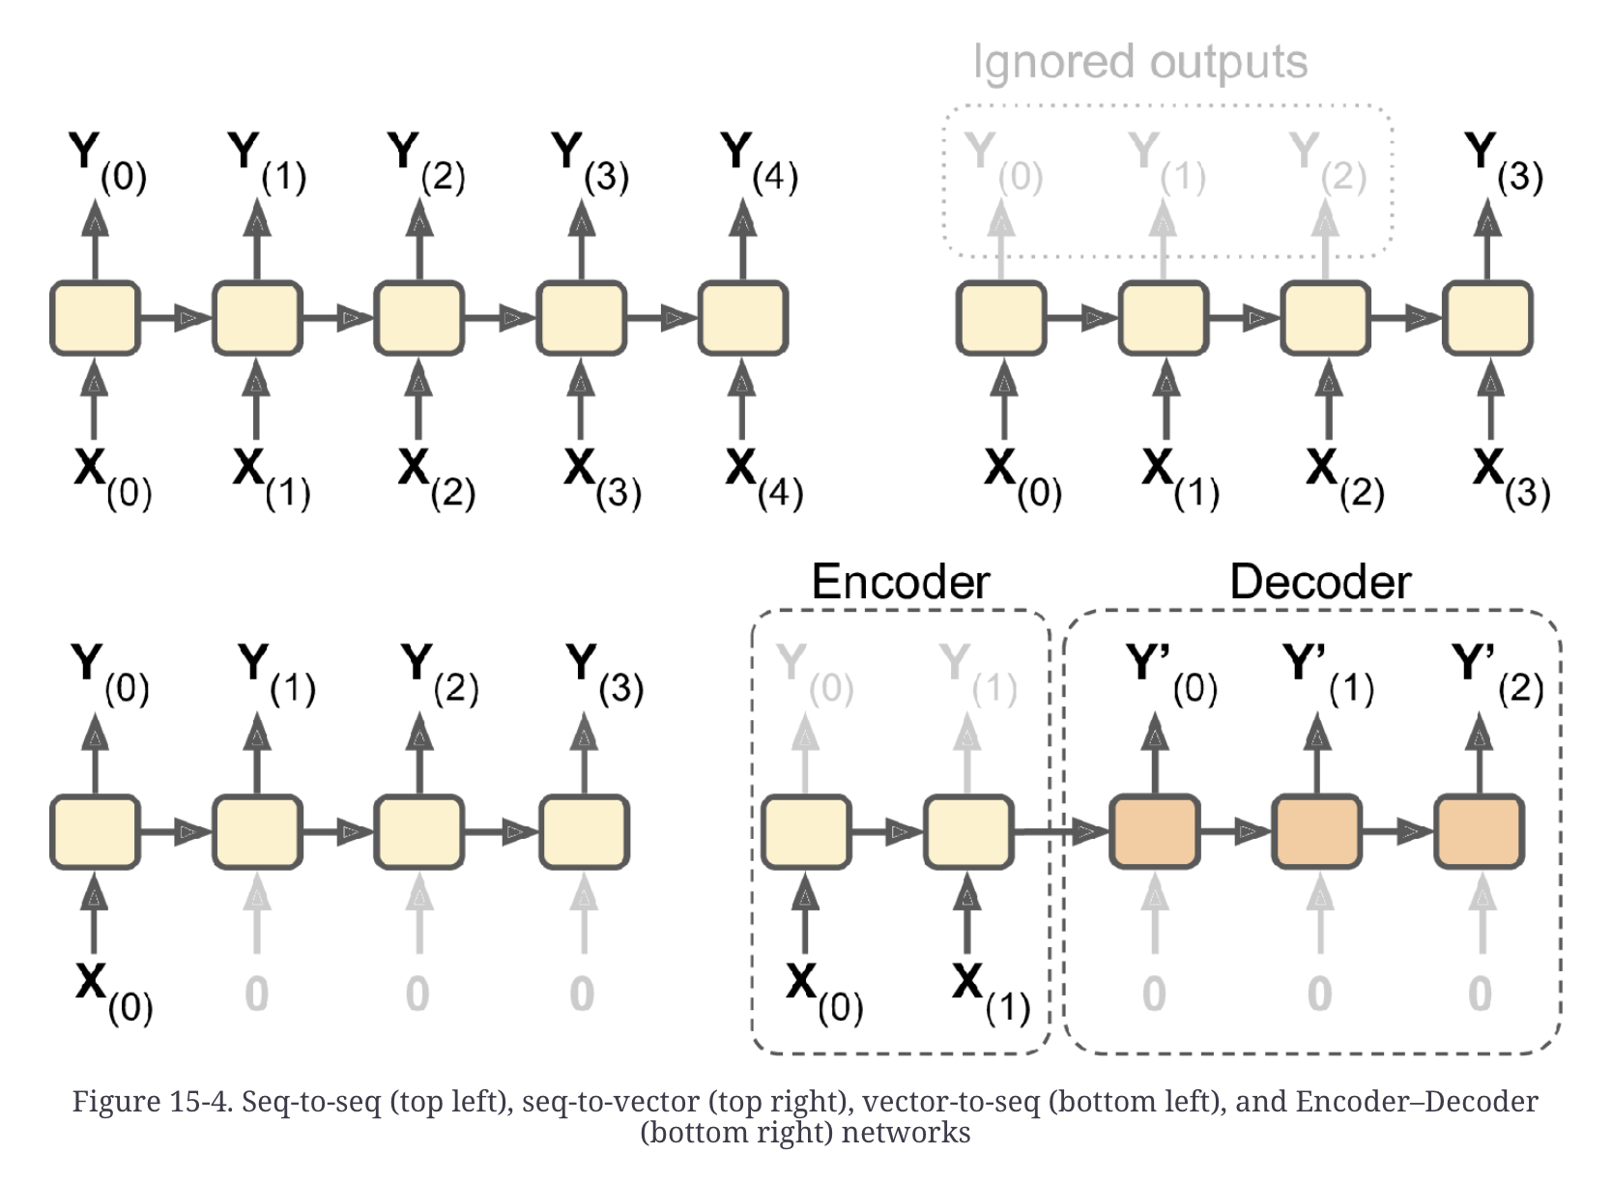
Multiple IO patterns

Slide 38
IO pattern examples
Sequence to sequence: amino acid sequence 🡺 secondary protein structure
Sequence to vector: daily RocketLab stock price since IPO 🡺 stock price tomorrow
Vector to sequence: Image 🡺 Caption
Encoder-Decoder: Translating from English to Māori

Slide 39
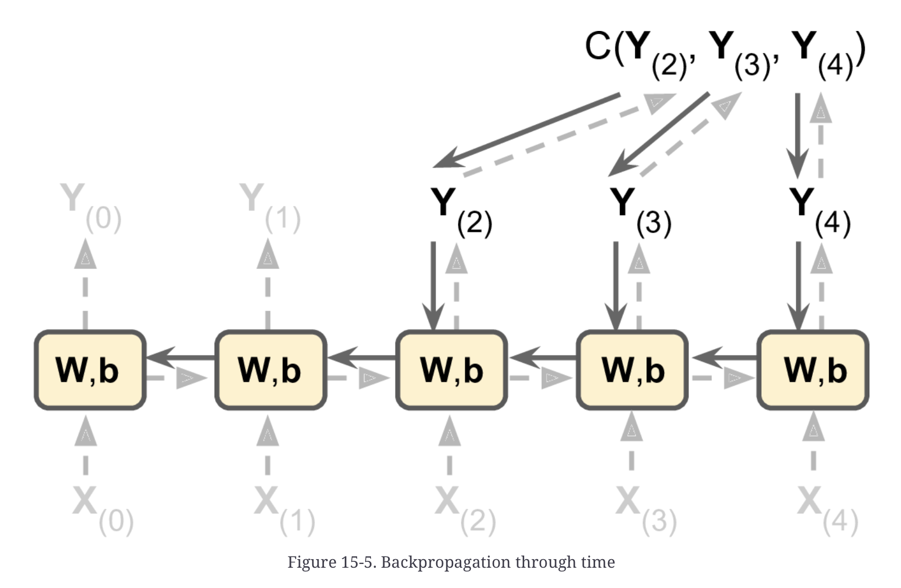
How to train?
Unroll, and use backpropagation: called BPTT - Backpropagation Through Time [Keras will do that for you].

Slide 40
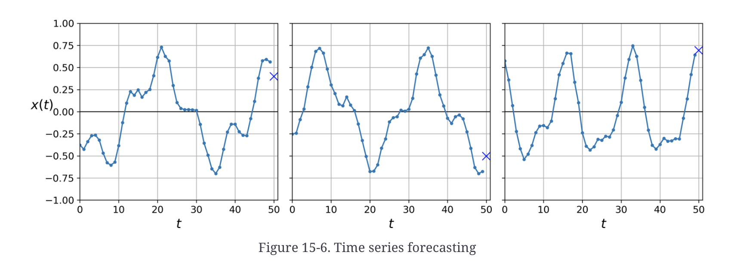
Forecasting example
Artificial time series generated: sum of 2 random sine waves plus some noise
Sequence to Vector

Slide 41
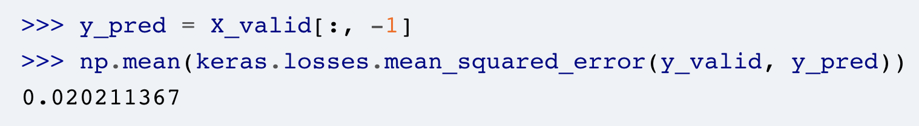
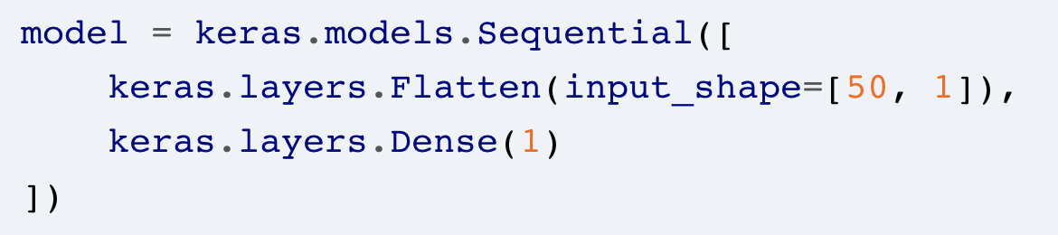
Simple baselines
Predict the last value
Simple linear regression, the Keras way:
🡺 MSE = 0.004

Slide 42
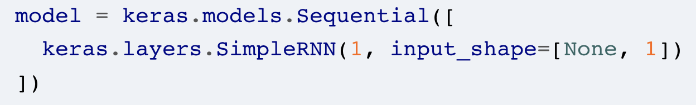
Simple RNN
MSE = 0.014
Try a larger model:
model = keras.models.Sequential([
keras.layers.SimpleRNN(20, return_sequences=True, input_shape=[None, 1]),
keras.layers.SimpleRNN(20, return_sequences=True),
keras.layers.SimpleRNN(1)
])
🡺 MSE = 0.003 ☺

Slide 43
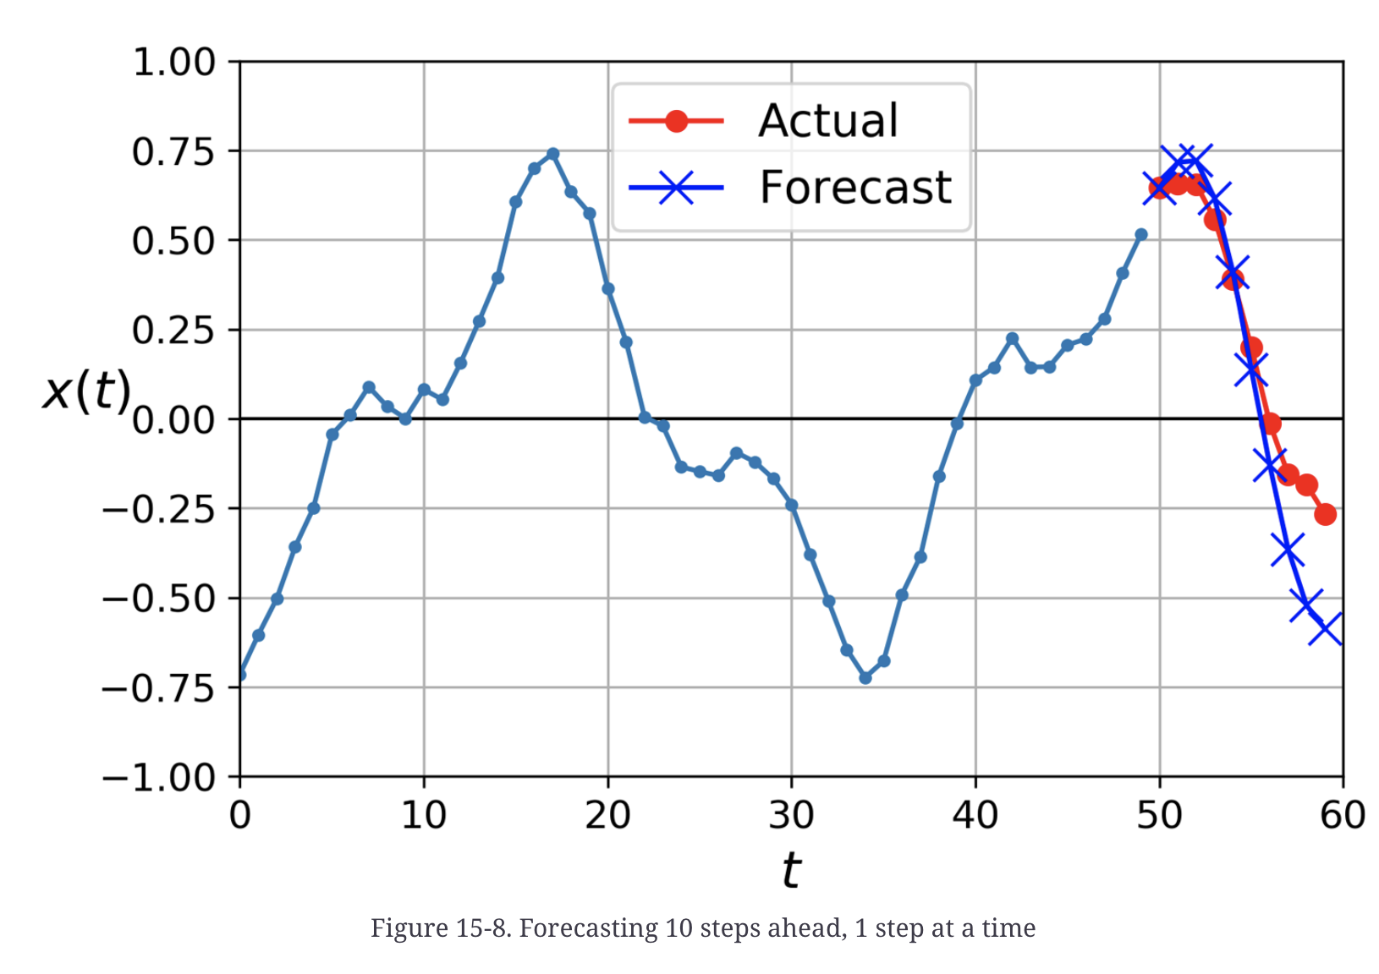
Predicting multipe steps
One way: predict first, add to input, predict second, …

Slide 44
Alternative
Predict the full output in one go:
model = keras.models.Sequential([
keras.layers.SimpleRNN(20, return_sequences=True, input_shape=[None, 1]),
keras.layers.SimpleRNN(20, return_sequences=True),
keras.layers.TimeDistributed(keras.layers.Dense(10))
])
MSE 0.006 (stepwise was 0.029)

Slide 45
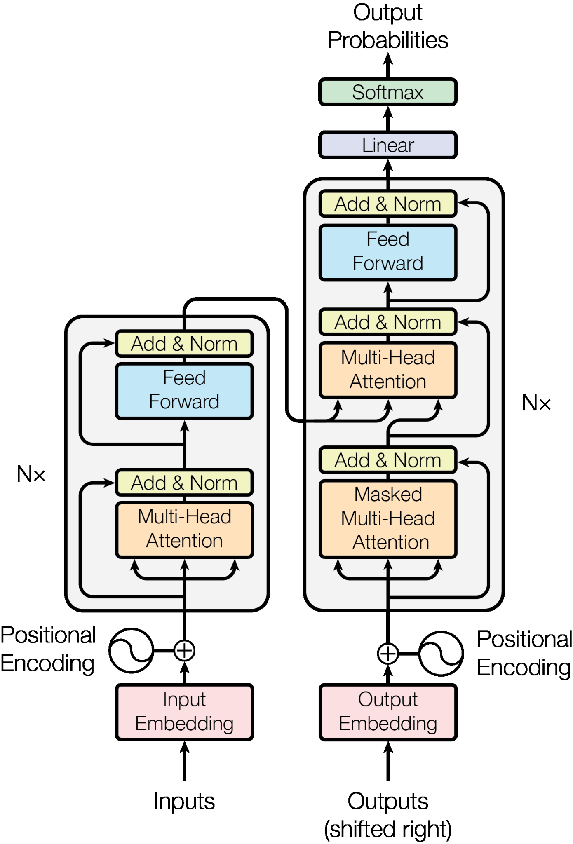
Transformers

Slide 46
Vanishing gradients
Opposite of ‘exploding gradients’, a zero gradient stops learning

Slide 47
Adaptive rates are better
Many ideas:
Power scheduling: r, r/2, r/3, r/4, …
Exponential scheduling: r, 0.1r, 0.01r, …
Piecewise constant: e.g. 0.1 for 5 epochs, then 0.001 for 50 epochs …
Performance scheduling: monitor validation set, reduce rate when validation error stalls
Use the callback LearningRateScheduler to do this
Generally, Performance scheduling and Exponential scheduling seem to be the best choice

Slide 48
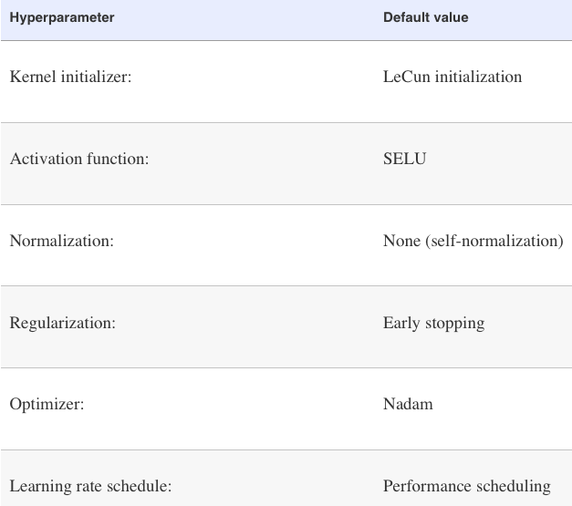
Good defaults in 2020s
If you train from scratch: scale input and use
ReLU
BatchNorm
Adam

